Slide 1



HEO Variants Benchmark Duel
Ali Soltani
2025/01/01

Slide 2

CONTENTS
01
Protocol & Zero-Minimum Suite
02
Zero-Minimum Results
03
Shifted Benchmark Arena
04
Numeric Conclusions

Slide 3

01
Protocol & Zero-Minimum Suite

Slide 4

Experimental Protocol Unveiled
A rigorous setup for a fair comparison of HEO variants.
30
100
1000
30
Dimension
Population
Iterations
Independent Runs
Benchmarks: Sphere, Rosenbrock, Rastrigin, Griewank, Levy and shifted versions with optimum at 123.456.

Slide 5
The Zero-Minimum Battleground
Where the global optimum is exactly zero, exposing raw optimizer performance.
Unimodal
Multimodal
Rugged
Tests convergence speed
Evaluates exploration
Assesses robustness

Slide 6
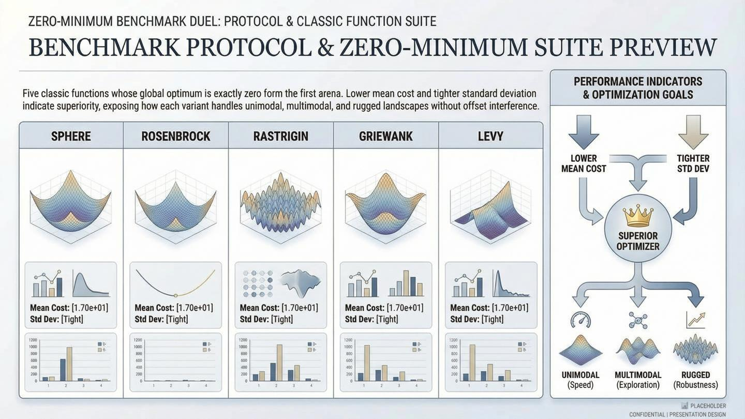
The Zero-Minimum Battleground
Where the global optimum is exactly zero, exposing raw optimizer performance.
Unimodal
Multimodal
Rugged
Tests convergence speed
Evaluates exploration
Assesses robustness

Slide 7
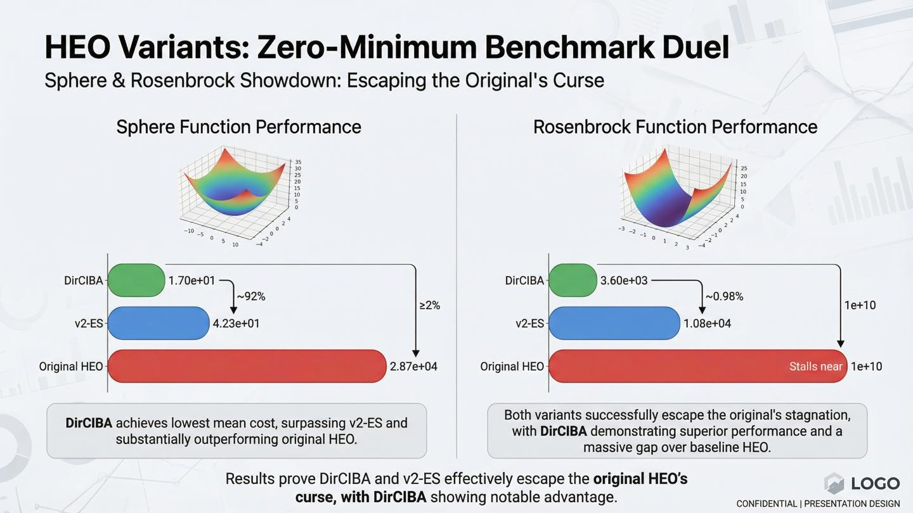
The Zero-Minimum Battleground
Where the global optimum is exactly zero, exposing raw optimizer performance.
Unimodal
Multimodal
Rugged
Tests convergence speed
Evaluates exploration
Assesses robustness

Slide 8
02
Zero-Minimum Results

Slide 9
Sphere & Rosenbrock Showdown
Sphere Function
Rosenbrock Function
DirCIBA
1.70e+01
VS
DirCIBA
3.60e+03
v2-ES
4.23e+01
v2-ES
1.08e+04
HEO
2.87e+04
HEO
~1e+10

Slide 10
Rastrigin & Griewank Face-Off
Rastrigin Function
Griewank Function
DirCIBA
2.63e+02
VS
CIBA
7.39e-01
v2-ES
2.97e+02
DirCIBA
7.56e-01
HEO
8.17e+00
v2-ES
9.23e-01

Slide 11
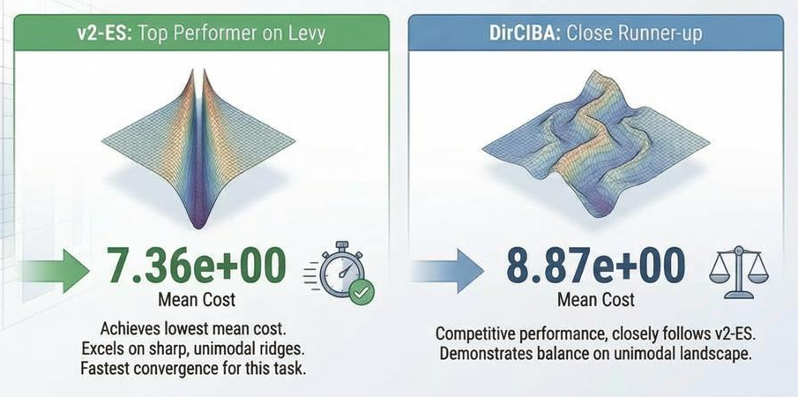
Levy Function Cliffhanger
A test of sharp unimodal ridges, where speed is key.
v2-ES
7.36e+00
DirCIBA
8.87e+00
HEO
8.11e+03

Slide 12
03
Shifted Benchmark Arena

Slide 13
Shifted Arena: Sphere & Rastrigin
Global optimum shifted to 123.456. Performance is measured by the gap to this optimum.
Shifted Sphere
Shifted Rastrigin
DirCIBA Gap
2109.51
VS
DirCIBA Gap
2084.36
v2-ES Gap
2611.64
v2-ES Gap
2379.53

Slide 14
Shifted Arena: Rosenbrock & Griewank
Continued assessment of robustness under an offset optimum.
Shifted Rosenbrock
Shifted Griewank
DirCIBA Gap
15211.02
VS
DirCIBA
1.38
v2-ES Gap
25444.31
v2-ES
1.40

Slide 15
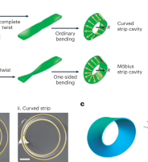
The Shifted Levy Twist
The one test where v2-ES prevails, highlighting a key trade-off.
v2-ES Gap: 621.99
Wins by leveraging fast convergence on sharp ridges.
DirCIBA Gap: 772.98
Loses ground, showing its focus on robustness can be a slight disadvantage.

Slide 16
04
Numeric Conclusions

Slide 17
The Verdict on Original HEO
Across all benchmarks, original HEO's performance is orders of magnitude worse with higher standard deviation. It provides no statistical wins and is unconditionally dominated by its enhanced variants.
The evidence is clear: The baseline is obsolete.

Slide 18
The Core Trade-Off: v2-ES vs. CIBA
v2-ES: The Speedster
CIBA: The Explorer
Delivers the fastest convergence on unimodal and Levy functions, making it ideal for quick solutions on clean problems.
Improves exploration capabilities, which is beneficial for complex landscapes, but can be slower to converge.
Sacrifices robustness when the optimum is shifted.
Shows instability near the true optimum, widening gaps when shifted.

Slide 19
DirCIBA: Crown Confirmed
Achieving the optimal balance of exploration, exploitation, and robustness.
Best overall mean on 4 of 5 zero-min benchmarks.
Wins 4 of 5 shifted tests, proving superior robustness.
Combines the lowest gaps with competitive standard deviation.

Slide 20

YOUR LOGO
THANK YOU
Ali Soltani
2025/01/01

